Slide 1
Forecasting Time-Varying Reactive Power Load of Power Systems by Hierarchical Extreme Learning Machine
Park Jee Hyun
08 JUL 2017
-
SungKyunGwan University – undergraduate student
Nanyang Technological University – exchange student

Slide 2
Contents
Introduction
Forecasting Techniques
Proposed Model for Reactive Power Forecasting
Application Results
Conclusion

Slide 3
1. Introduction
short-term load forecasting (STLF) aims to predict hourly load for a leading time ranging from one hour to several days.
The results are used by fundamental operating functions such as unit commitment, economic dispatch, and security assessment.
Reactive power provides a crucial element to efficiently and reliably perform management of reactive resources and thus voltages.
Reactive power demand is also a time-varying variable and not always corresponding to the active load.

Slide 4
1. Introduction
The contribution of this paper consists of developing an effective tool for short-term reactive power load forecasting, with such a tool the time-varying reactive load can be properly predicted (with a reasonable accuracy).
The forecasted reactive power demand can be used to
1) optimally schedule the reactive resources (e.g., switching shunt capacitor banks) to minimize the reactive power flow over transmission lines and therefore reduce the network power loss,
2) regulate voltage profiles more effectively, and
3) help system planners and operators to gain deeper insights into the reactive power load characteristics for better decision-making in planning and operating practices.

Slide 5
2. Forecasting Techniques
Hierarchical Extreme Learning Machine

Slide 6
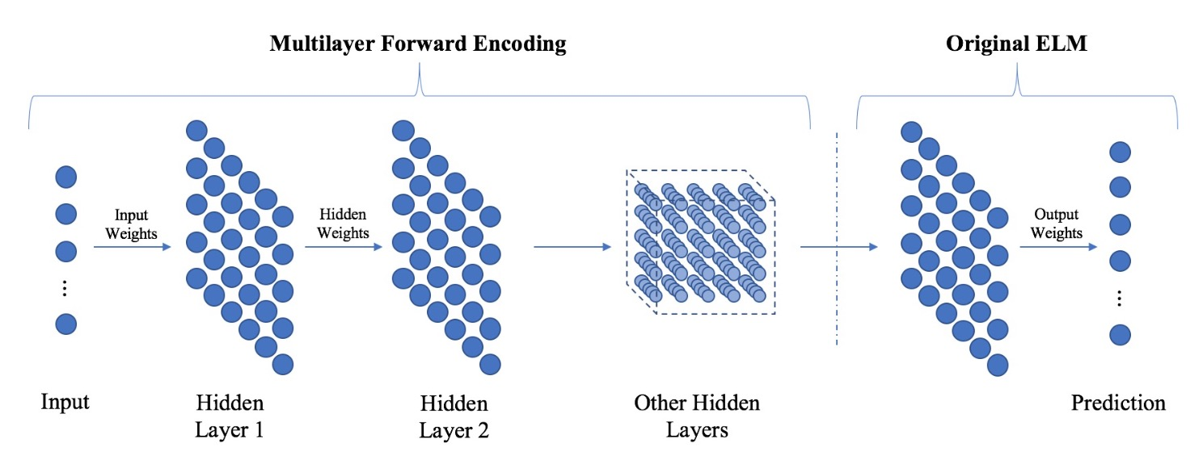
2.a. Hierarchical Extreme Learning Machine
HELM consists of two parts
Unsupervised hierarchical feature representation
Supervised feature classification

Slide 7
2.a. Hierarchical Extreme Learning Machine
Unsupervised hierarchical feature representation
It receives raw input data and projects it to the ELM random feature space, which plays an important role in extracting hidden feature information of input training data.
High-level sparse features can be obtained as output values through N-layer unsupervised learning, which is then passed to the input data of the second stage.
Supervised feature classification
The final decision is made through regression, which is the same process as the existing ELM.
Notes:
Since H-ELM receives input of high-level sparse features obtained from unsupervised feature learning, instead of raw input data,
it is able to obtain more accurate and stable performance.
The experiments designed in the back will confirm that H-ELM shows better performance than ELM.

Slide 8
3. Proposed Model
STLF Model structures by H-ELM
Input selections for STLF Model

Slide 9
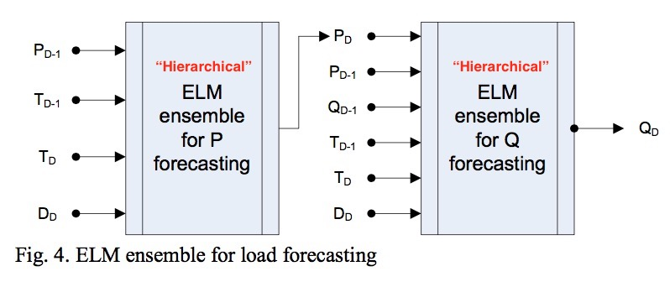
3.a. STLF Model structures by H-ELM
H-ELM for load forecasting
Notes:
ELM is completely different from traditional iterative learning algorithms
as it randomly selects the input weights and biases for hidden nodes,
ω and b and analytically calculates the output weights, β, by finding least-square solution [8].
once ELM parameters of hidden layers of the ELM are generated randomly, it does not need to be tuned. Therefore, its training speed can be thousands of times faster [3].

Slide 10
3.b. Input selections for STLF Model
Load-related vector
Hourly reactive load of day D-1 : Q_{D-1}(i) → data_p
Hourly active load of day D-1 : P_{D-1}(i) → data_p
Hourly active load of day D : P_{D}(i) → data_q
Weather-related vector
Hourly temperature of day D-1 : T_{D-1}(i) → data_w
Hourly temperature of day D : T_{D}(i) → data_w
Day index-related vector
D_{D} is coded as 0.1 to 0.7 for Monday to Sunday, and 0.6 for public holiday. → date_p
Notes:
ELM is completely different from traditional iterative learning algorithms
as it randomly selects the input weights and biases for hidden nodes,
ω and b and analytically calculates the output weights, β, by finding least-square solution [8].
once ELM parameters of hidden layers of the ELM are generated randomly, it does not need to be tuned. Therefore, its training speed can be thousands of times faster [3].

Slide 11
4. Application Results
Tuning parameters
Generalization Performance
Comparisons with other algorithm

Slide 12
4.a. Tuning parameters
Optimization of proposed H-ELM STLF model
Notes:
ELM is completely different from traditional iterative learning algorithms
as it randomly selects the input weights and biases for hidden nodes,
ω and b and analytically calculates the output weights, β, by finding least-square solution [8].
once ELM parameters of hidden layers of the ELM are generated randomly, it does not need to be tuned. Therefore, its training speed can be thousands of times faster [3].

Slide 13
4.b. Generalization Performance
Generalization test results
Notes:
ELM is completely different from traditional iterative learning algorithms
as it randomly selects the input weights and biases for hidden nodes,
ω and b and analytically calculates the output weights, β, by finding least-square solution [8].
once ELM parameters of hidden layers of the ELM are generated randomly, it does not need to be tuned. Therefore, its training speed can be thousands of times faster [3].

Slide 14
4.3. Comparisons with ELM algorithm
H-ELM vs. SaDE vs. ELM
Notes:
ELM is completely different from traditional iterative learning algorithms
as it randomly selects the input weights and biases for hidden nodes,
ω and b and analytically calculates the output weights, β, by finding least-square solution [8].
once ELM parameters of hidden layers of the ELM are generated randomly, it does not need to be tuned. Therefore, its training speed can be thousands of times faster [3].

Slide 15
5. Conclusion

Slide 16
Notes:
ELM is completely different from traditional iterative learning algorithms
as it randomly selects the input weights and biases for hidden nodes,
ω and b and analytically calculates the output weights, β, by finding least-square solution [8].
once ELM parameters of hidden layers of the ELM are generated randomly, it does not need to be tuned. Therefore, its training speed can be thousands of times faster [3].

Slide 19
Notes:
ELM is completely different from traditional iterative learning algorithms
as it randomly selects the input weights and biases for hidden nodes,
ω and b and analytically calculates the output weights, β, by finding least-square solution [8].
once ELM parameters of hidden layers of the ELM are generated randomly, it does not need to be tuned. Therefore, its training speed can be thousands of times faster [3].

